Slide 1
Ensemble Learning
Ensemble Learning
Bagging
Bagged Trees
Random Forest
Boosting

Slide 2
Ensemble Learning
Ensemble Learning
Using multiple learning algorithm together for the same task
Better prediction than individual model
Better Accuracy
Higher Consistency (Avoids Over-fitting)
Reduce bias and variance error

Slide 3



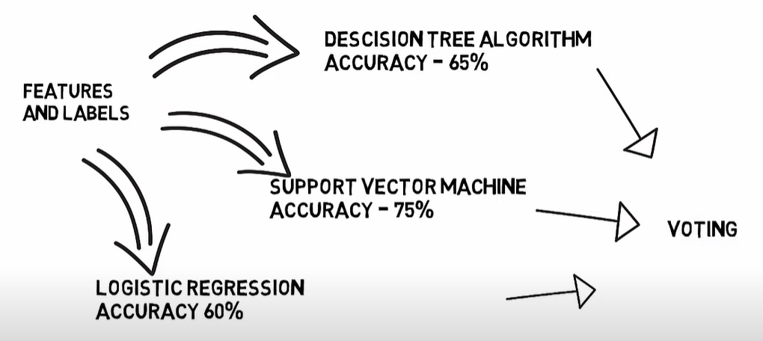
Ensemble Learning
Example
Suppose we have a training dataset with pixel of images and we prepare three model with these

Slide 4
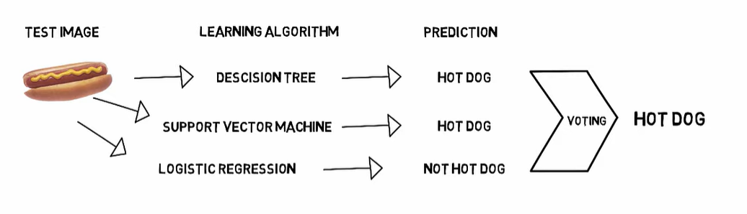
Ensemble Learning

Slide 5
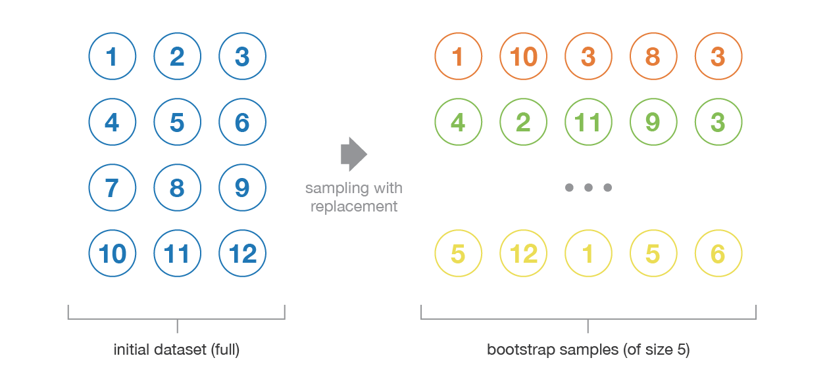
Bagging
Bagging
Bootstrap Aggregating, also knows as bagging, is a machine learning ensemble meta-algorithm designed to improve the stability and accuracy of machine learning algorithms used in statistical classification and regression
Sampling & Replacement

Slide 6
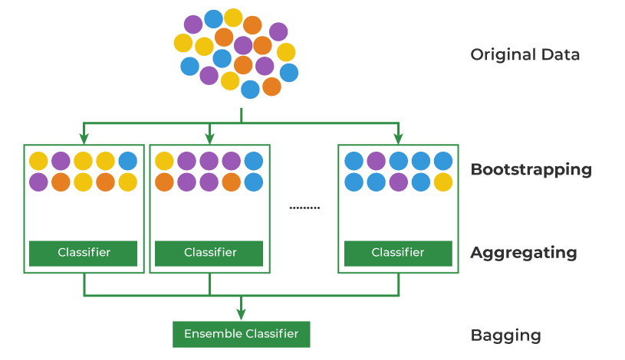
Bagging

Slide 7
Bagged Trees
Bagging: Underline model can be anything (SVM, KNN, Logistic Regression, Decision Tree etc
Bagged Trees: Each model is only Decision Tree

Slide 8
Random Forest
Random forests or random decision forests is an ensemble learning method for classification, regression and other tasks that operates by constructing a multitude of decision trees at training time.
It is a Bagged Tree
There are major two distinctions,
Here data set (rows) as well as features (columns) are sampled.
Each model is only Decision Tree

Slide 9
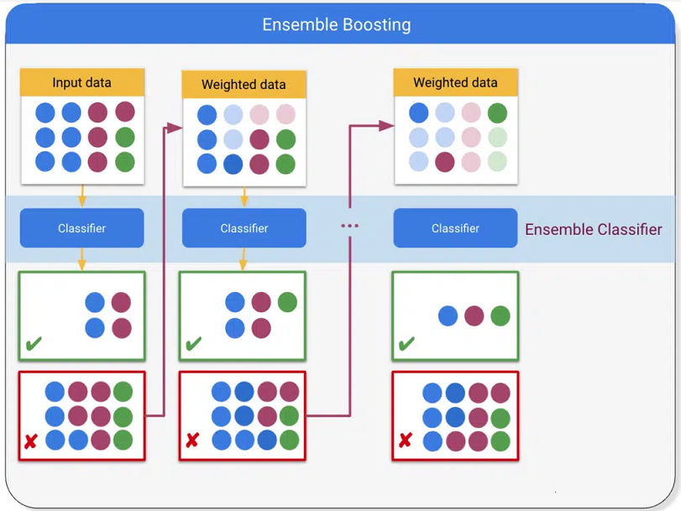
Boosting
Boosting is an ensemble learning method used in supervised learning that converts weak learners into strong learners by having each predictor fix the errors of its predecessor.

Slide 10
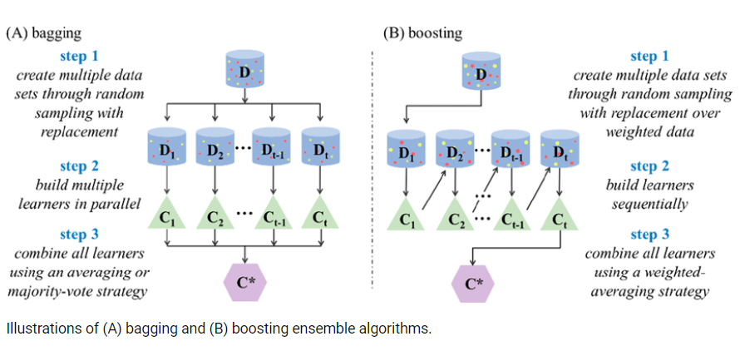
Bagging v/s Boosting

